Slide 1
Module 4: Testing and Validating a Repository
Analytics: Server Architect (Siebel 7.7)
Notes:
Time: Lecture: approximately 30 minutes; lab: see Lab Guide for timings.
Intent: This module presents techniques for testing and validating a repository.
Flow: Discusses general concepts and then provides the details regarding each step in the verification process.
Key Terms:
Consistency check
Logging levels
4

Slide 2

Module Objectives
After completing this module you will be able to:
  Describe techniques for testing a repository
  Execute steps to validate and test a repository
Why you need to know:
  Testing and validating the repository file before making it available to users helps ensure implementation success
Notes:
Each objective and “why you need to know” should be stated aloud.

Slide 3
Validating the Repository
Verifies that the business model yields correct results
  ABC has modeled the data requirements and now it is time to test and validate the repository
Validation techniques include:
  Check repository for consistency
  Turn on logging
  Check business model using Siebel Analytics ODBC Client
  Use Siebel Answers
  Check results by inspecting SQL
Notes:
This is a structuring slide. The bullets are covered in more detail on subsequent slides.
4

Slide 4
Check Repository for Consistency
A feature in the Administration Tool that checks the metadata in the repository for certain kinds of errors, including:
  Finding logical columns that are not mapped to physical sources
  Checking for undefined logical join conditions
  Determining if physical tables referenced in a business model are not joined to tables referenced in the business model
Does not guarantee that the business model is constructed correctly
Notes:
Repositories in online mode and the business models within them must pass the consistency check before you can make them available for queries. When a repository or business model is inconsistent, a detailed message alerts you to the nature of the inconsistency. Note: The consistency check algorithm has been enhanced for Siebel Analytics Version 7.8.2. After upgrading from a previous Siebel Analytics software version and checking the consistency of your repository, you might see messages that you had not received in previous consistency checks. This typically indicates inconsistencies that had been undetected prior to the upgrade, not new errors.
Consistency check messages are of three types: error, warning, and informational.
Consistency error messages indicate errors that need to be fixed. Use the information in the message to correct the inconsistency, and then run the consistency check again.
Consistency warning messages indicate conditions that may or may not be errors, depending upon the intent of the Siebel Analytics Server administrator. For example, a warning message about a disabled join may be the result of the administrator intentionally disabling a join, such as eliminating a circular join condition.
Consistency informational messages provide information about conditions but do not indicate an inconsistency. The following is an example of an informational message: Fact table does not contain logical key.

Slide 5
Turn On Logging
Test proper repository configuration by logging query activity
  Use logging for testing, debugging, and technical support
  Query activity gets logged in NQQuery.log file
Enable for individual users
  Set logging level for each user whose queries you want logged
Query logging is disabled by default
  Can quickly produce very large log files
Notes:
Because query logging can produce very large log files, the logging system is turned off by default. It is sometimes useful, however, to enable logging to test that your repository is configured properly, to monitor activity on your system, to help solve performance problems, or to assist Siebel Systems Technical Support. You need to enable logging on the system for each user whose queries you want logged.
4

Slide 6
Turn On Logging Continued
To see the SQL generated, set logging level to 1 or 2
Level 1 Logs: | Level 2 Logs:
User name, session ID, and request ID for each query | All items for Level 1, plus:
SQL for the request using business model names | Repository name, business model name, presentation catalog name
Query status (success, failure, termination, or timeout) | SQL for the request using physical data source syntax
Elapsed times for query compilation, execution, query cache, and back-end database processing | Queries issued against the cache
 | Number of rows returned from a physical database
 | Number of rows returned to the client
Notes:
You must set the logging level for an individual user. You cannot turn on logging for all users or a group of users. The table shows some differences in the logging levels. Level 2 provides more detailed information than Level 1. Set the logging level based on the amount of logging you want to do. In normal operations, logging is generally disabled (the logging level is set to 0). If you decide to enable logging, choose a logging level of 1 or 2. These two levels are designed for use by Siebel Analytics Server administrators. Logging levels greater than 2 should be used only with the assistance of Siebel Technical Support. Refer to the Siebel Analytics Server Administration Guide for a complete description of logging levels. You can turn on the logging levels in online mode by checking out the users, setting the logging levels, checking in the users, saving the changes to the repository, and refreshing (or reloading) the server metadata.

Slide 7
Check Business Model Using Siebel Analytics ODBC Client
ODBC Client is a tool that allows you to:
  View the database schema
  Create new SQL queries and save them
Use the ODBC Client to validate the business model
  Verify that the data elements and joins work as expected
Compare query results from ODBC Client with the results generated by Siebel Answers
Notes:
The ODBC Client Tool is generally used by the developer or administrator to help validate the model. You can use this before you test using Siebel Answers. If logging is turned on, the queries are saved in the log file.
4

Slide 8
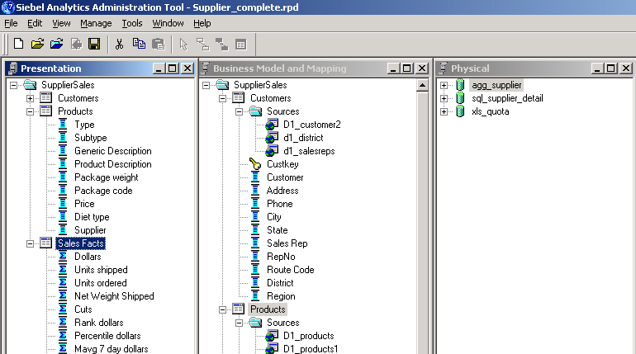
ABC Example
Test the business model before making it available to end users
ABC users will query the SupplierSales subject area to get answers
Notes:
Up to this point in the course, you have created a model, but have not yet verified it or made it available for querying by users. The following slides describe the steps that can be used to test the model.

Slide 9
Verification Steps
0/8
1. Check consistency
2. Set query logging level
3. Define repository name in initialization file
4. Start Siebel Analytics Server
5. Use ODBC Client to verify repository
6. Execute SQL to verify results
7. Examine the query log file
8. Test business model using Siebel Answers
Notes:
This is a structuring slide. Do not teach the steps or concepts here because subsequent slides cover them in detail.
4

Slide 10
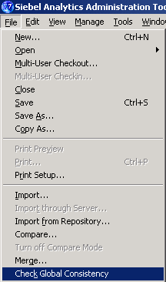
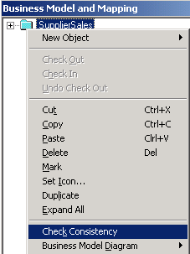
1. Check Consistency
1/8
Validate repository for certain kinds of errors
  Can validate entire repository or a single business model
Right-click business model and select Check Consistency to check compilation errors in a particular business model
Select File > Check Global Consistency to check for compilation errors in the entire repository
Notes:
When you save changes in the .rpd file, you are prompted to check for consistency. It is generally a good idea to do so. You can also explicitly check consistency by selecting the menu option. You would opt not to check for consistency if you are saving interim work (and you know it is not yet complete) and during your initial model building.
Checking consistency at the Business Model layer does not check consistency of the Presentation layer. You need to check consistency on the entire repository to include the Presentation layer.

Slide 11
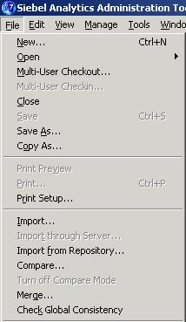
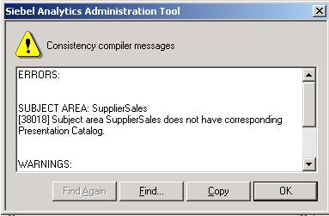
1. Check Consistency Continued
1/8
Any errors are displayed in a dialog box
  Correct the errors and check for consistency again
  Repeat the process until there are no more errors
Notes:
The errors are flagged as true errors or warnings. Some messages are just warnings, letting the administrator know of certain conditions that may not necessarily be consistency errors.
4

Slide 12
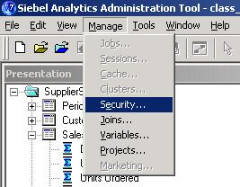
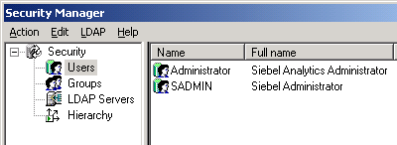
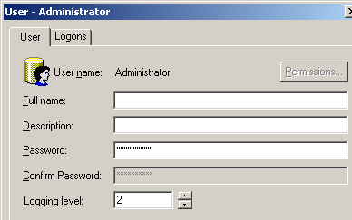
2. Set Query Logging Level
2/8
Select Manage > Security to open Security Manager
Select Users (in left pane) to display the users (in right pane)
Set the appropriate
logging level for user
Notes:
You must set the logging level per individual user. This is done through the Security Manager. The Security Manager is discussed in more detail later in the course.

Slide 13
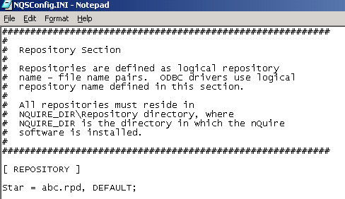
3. Define Repository Name in Initialization File
3/8
Open c:\SiebelAnalytics\Config\NQSConfig.ini
In the repository section, add an entry for your repository file
  Format: logical_name = repository_file_name
ABC’s repository file
Notes:
You may add a new entry or alter the existing entry. Adding a leading # sign causes the line to be treated as a comment. If the Analytics Server fails quickly upon startup, a common cause is a typo in the file name or the file is not in the default directory \SiebelAnalytics\Repository.
4

Slide 14
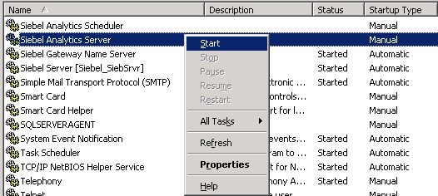
4. Start Siebel Analytics Server
4/8
Use Windows service manager to start the server and load the repository file into memory
  Upon Siebel Analytics Server startup, repository file defined in NQSConfig.ini becomes available for querying
Right-click the service and select Start
Notes:
When the repository is modified offline, you need to restart the Siebel Analytics Server to reread the .rpd file (reload the metadata). When the repository is modified online, you can reload the repository by selecting Reload Server Metadata in Siebel Answers. Online administration should be limited to minor repository changes.

Slide 15
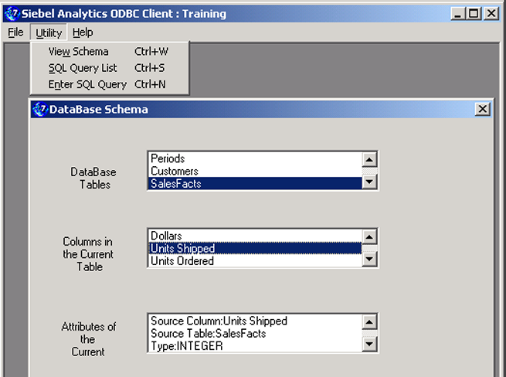
5. Use ODBC Client to Verify Repository
5/8
Test and verify that the repository displays the correct tables and columns
Lists all tables in
default repository
Lists all columns in
selected table
Lists attributes of
selected column
Notes:
Using this tool is a simple way to test whether the Analytics Server is able to process queries. It does not involve the Siebel Analytics Web Server as does Siebel Answers.
4

Slide 16
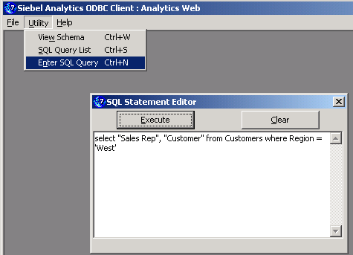
6. Execute SQL to Verify Results
6/8
Verify the logical and physical model
  Use logical column names in the SELECT clause
  Use logical table name or logical subject area name in the FROM clause
  Use any restrictions in a WHERE clause
Enter SQL query
and click the
Execute button
Notes:
In the Analytics ODBC Client Tool you can use the logical names in queries, which will verify the mappings from the Business Model and Mapping layer to the Physical layer.

Slide 17
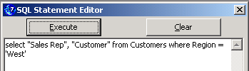
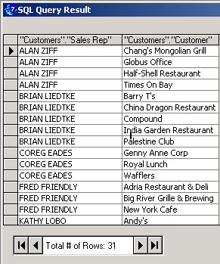
6. Execute SQL to Verify Results Continued
6/8
Examine the results
  To further verify, you can double-check these results with results from the Database Query Tool
Verify that data is as expected
Notes:
To further verify, you may want to compare results between the Analytics ODBC Client Tool and the data source query tool.
4

Slide 18
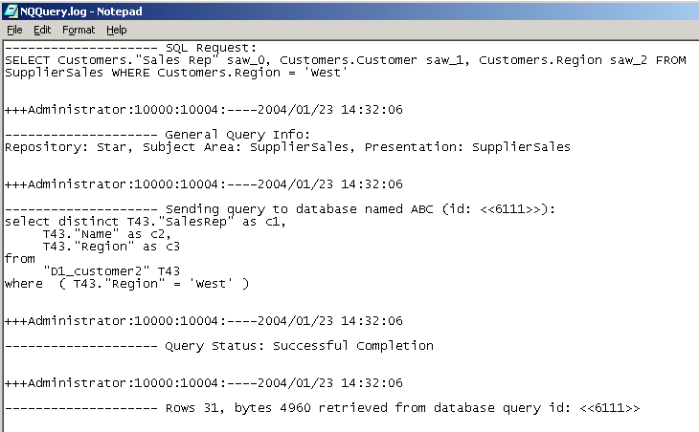
7. Examine the Query Log File
7/8
Check SQL generated by Siebel Analytics Server to verify that the server is querying correct table(s) and column(s)
  Open c:\SiebelAnalytics\Log\NQQuery.log
  Verify that joins and data elements work as expected
Select statement executed by ODBC Client to verify repository
Verify that correct repository, subject area, and presentation catalog were queried
SQL statement sent to the database
Number of rows returned
Notes:
If logging is enabled, the details of the query issued to satisfy the request are logged in the NQQuery.log file. Use the log file to verify queries and results are as expected.

Slide 19
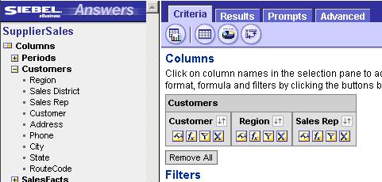
8. Test Business Model Using Siebel Answers
8/8
Query business model to ask factual questions and get answers
Compare results generated by Siebel Answers to the query results from the Siebel Analytics ODBC Client and in the NQQuery.log file
ABC users query SupplierSales to get answers
Notes:
If the ODBC client yields correct results, you can further test the repository by using Siebel Answers. This will verify the Presentation layer, in addition to the other layers.
4

Slide 20
Summary
This module showed you how to:
  Describe techniques for testing a repository
  Execute steps to validate and test a repository
Notes:
Review Questions:
Question: True or False: You must validate a repository file before saving it?
Answer: False. You can save interim work without running a consistency check.
Question: True or False: You must use the ODBC Client Tool to validate your results?
Answer: False. Using the tool is optional. You can test directly in Siebel Answers.
Question: True or False: You can turn on logging by setting a variable in the INI file?
Answer: False. You must use the Security Manager and set the level for an individual user.
Question: True or False. You must correct every error displayed during a consistency check.
Answer: False. Some errors are warnings and may not impact your overall model; however, it is generally a good idea to correct them.

Slide 21
Lab
In the lab you will:
  Test and validate the repository file
Notes:
Labs and Troubleshooting:
See Lab Guide for details.
If students made errors in previous labs, here is where they will be detected. It is best to help them correct the errors. However, if you run out of time, you can use the provided solution files.
Be careful with the syntax in the INI file. If the server fails to start quickly, verify that the file is in the correct location and the name is properly reflected in the INI. The server should start quickly since the .rpd file is small.
Lab 4-2: This lab is optional and intentionally introduces an error. If the students mistakenly save ABC_LAB4.rpd as ABC.rpd, future consistency checks will flag the error. You can recover by using a solution file or copying the .rpd from another student.
4

